Slide 1


MANUFACTURING ANALYSIS
- INNOVATION, EFFICIENCY AND QUALITY IN EVERY PRODUCTION
GROUP-1

Slide 2

Sahil Rajesh Gupta Kasoju Akshitha Manasi Prashant Daph Ganesh Amar Dudhal Kajol Prasad Satardekar Khushi Meghe Vishal Prasad
Group Members:

Slide 3

Aim of the Project:
1
2
To provide a comprehensive view of manufacturing performance through key KPIs such as efficiency rate, machine utilisation, and production output.
To help management track daily, monthly, and yearly production trends for effective decision-making.
3
4
To identify bottlenecks in processes and highlight areas of improvement for increasing overall efficiency.
To support data-driven strategies that reduce costs, improve productivity, and enhance operational performance.

Slide 4
Objectives of the Project:
1
2
Track production, rejection,
and delivery
performance to understand
overall efficiency
To present daily, monthly, and department wise outputs in a clear and simple view
3
4
Applied SQL queries to calculate
employee work, machine cost, repeat orders, and delivery trends.
Delivered insights that helped improve quality, reduce waste, and support better planning.

Slide 5
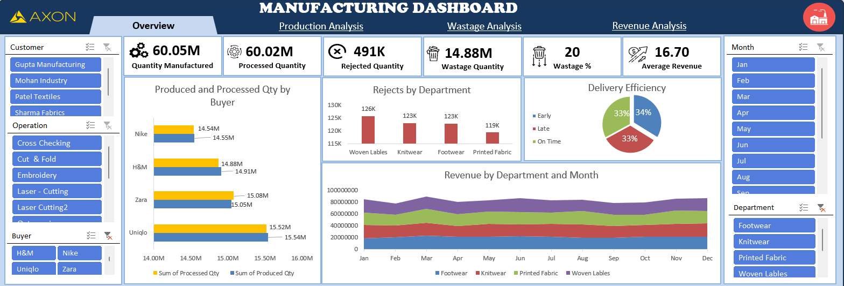
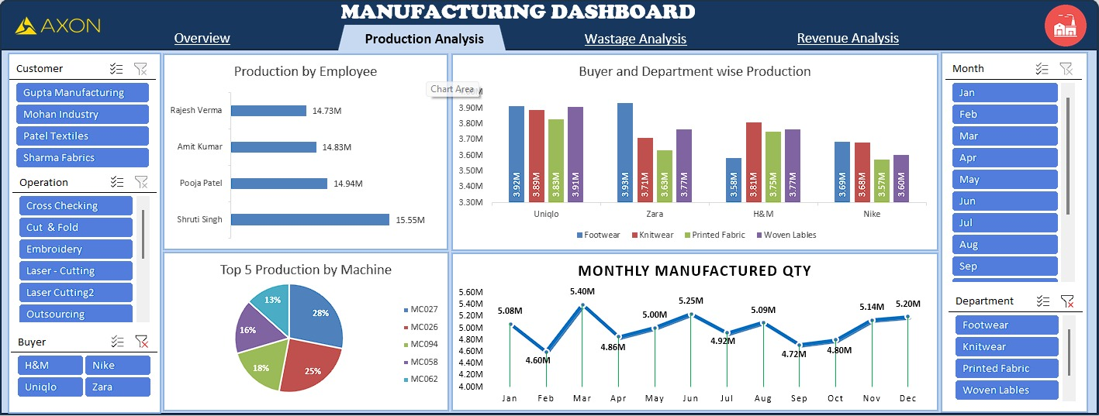
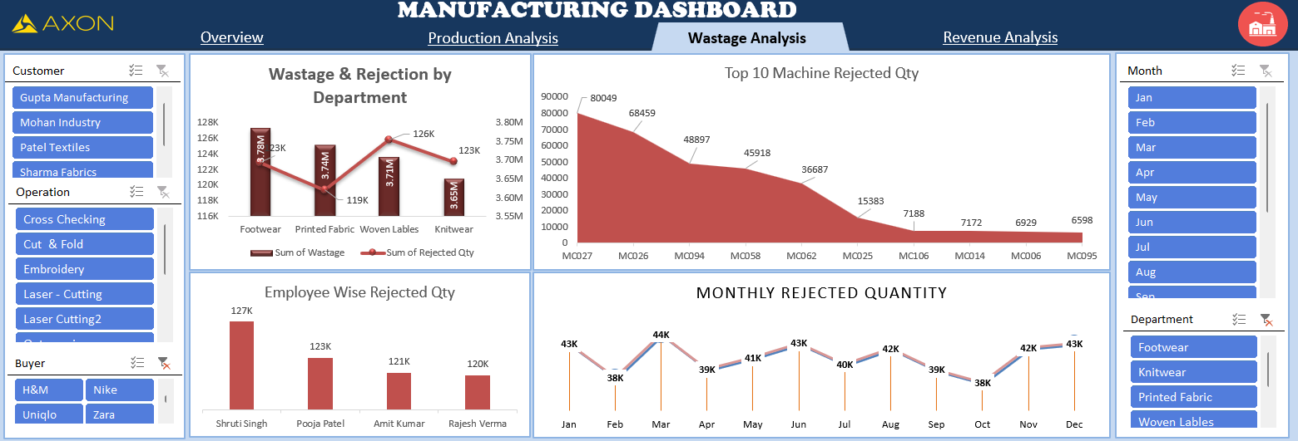
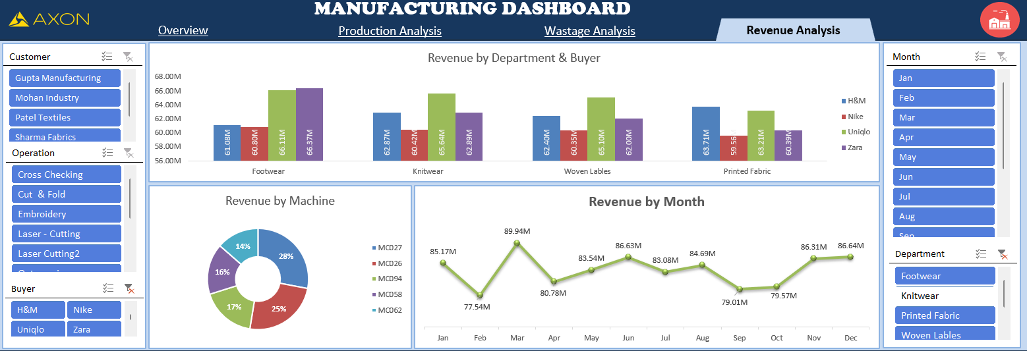
Excel Dashboard
Excel Dashboard

Slide 6
Excel Dashboard

Slide 7
Excel Dashboard

Slide 9
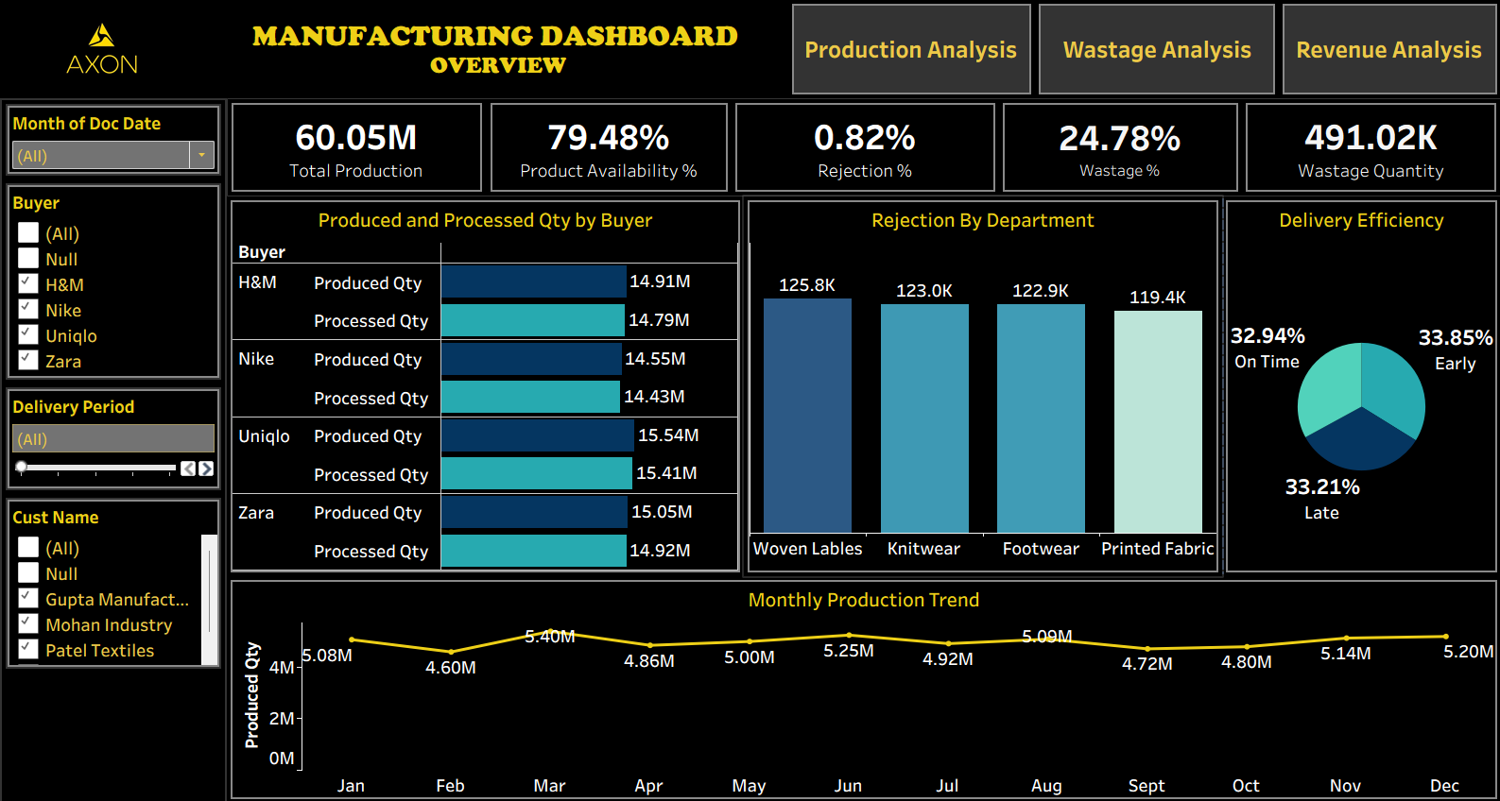
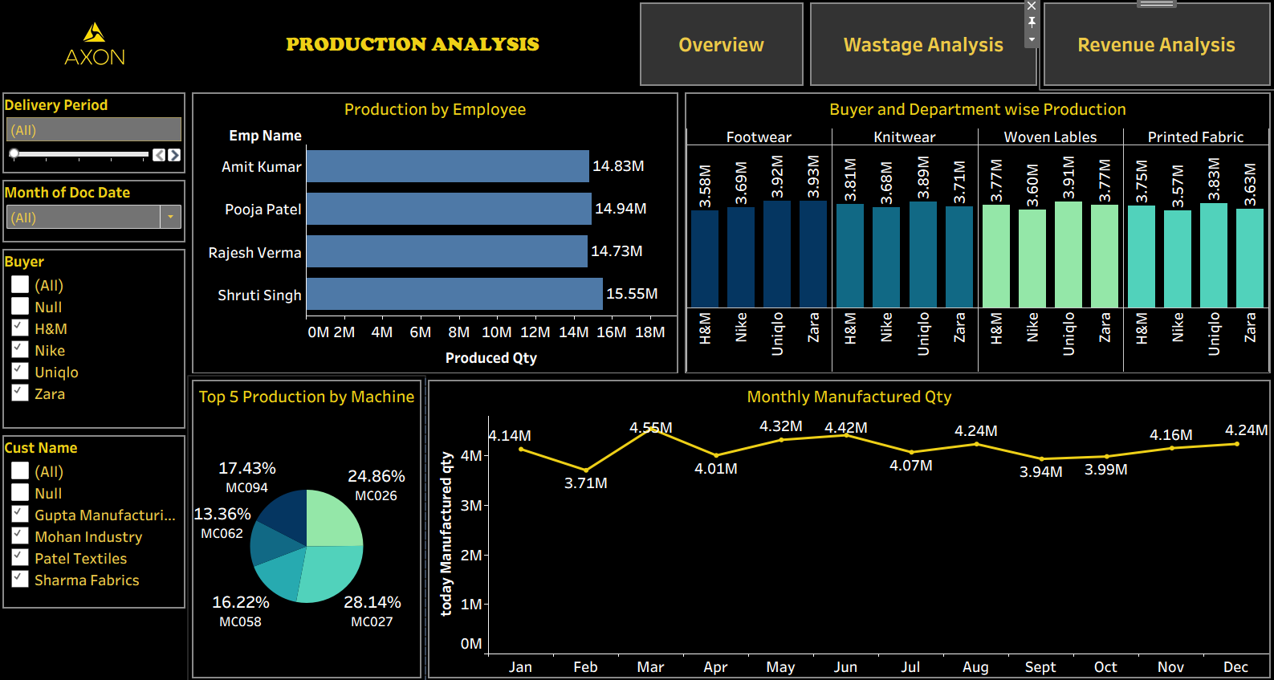
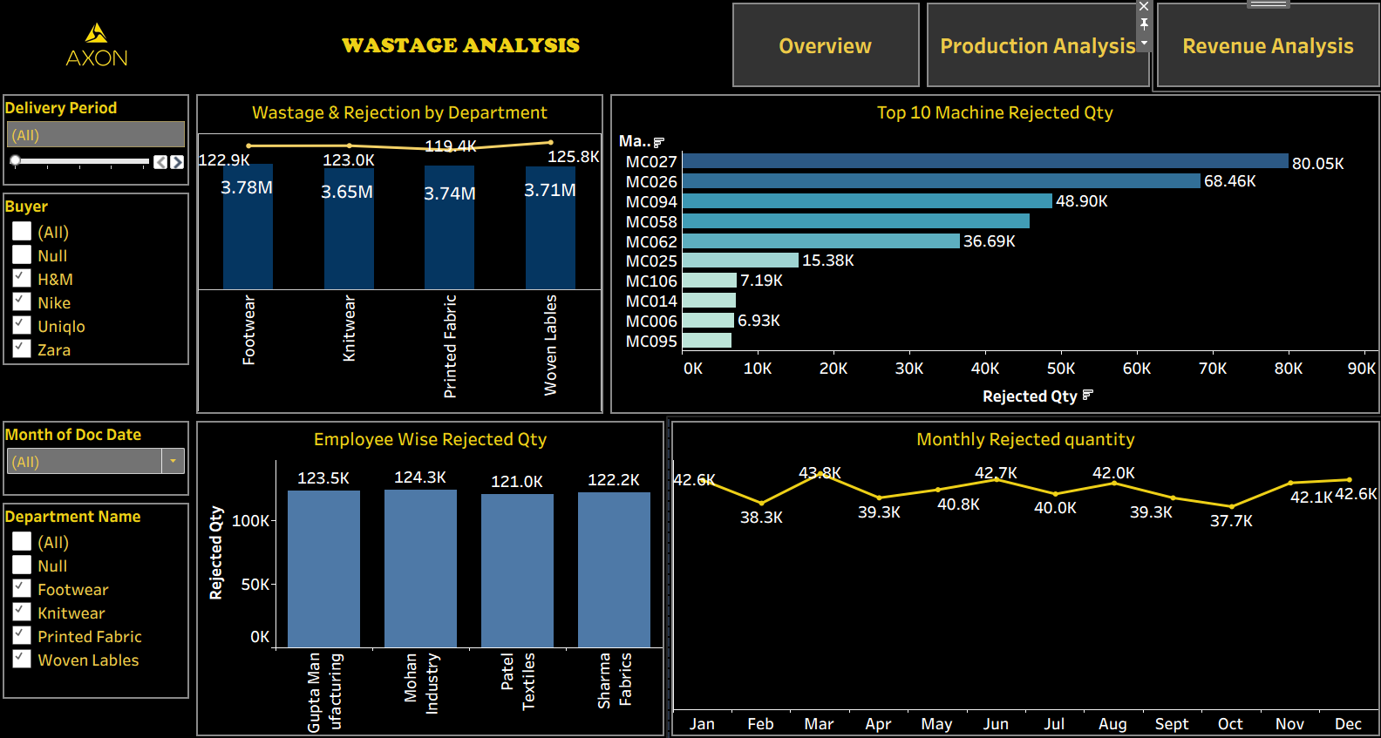
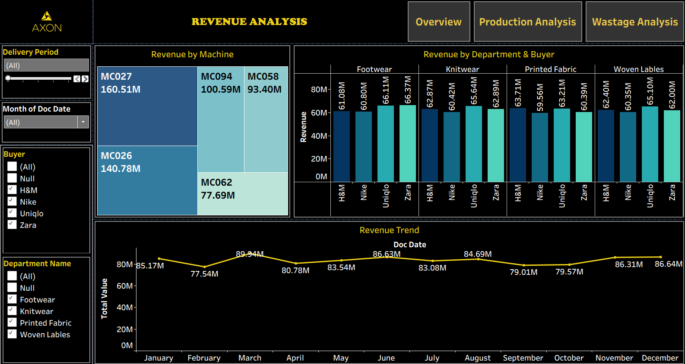
Tableau Dashboard

Slide 13
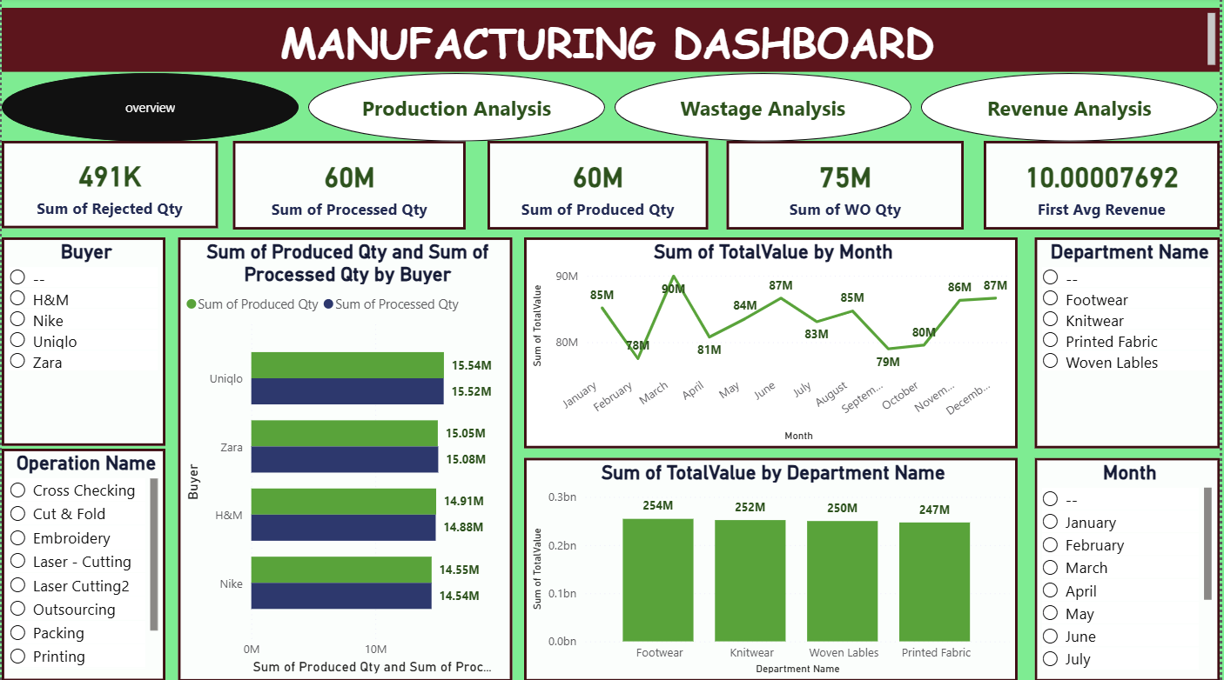
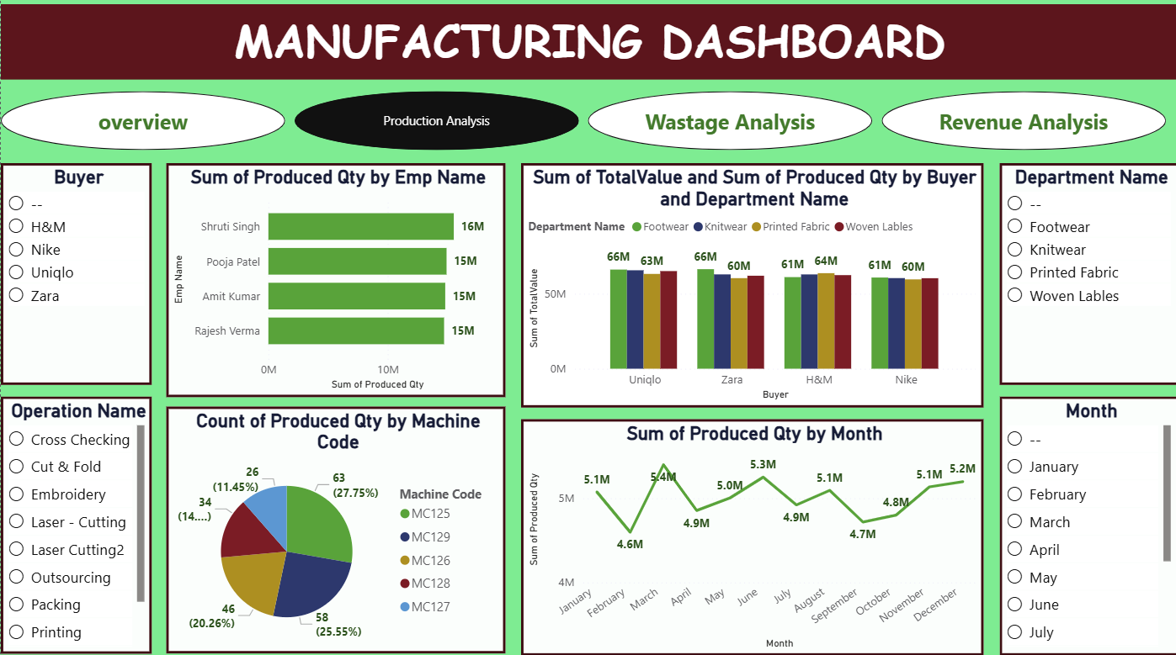
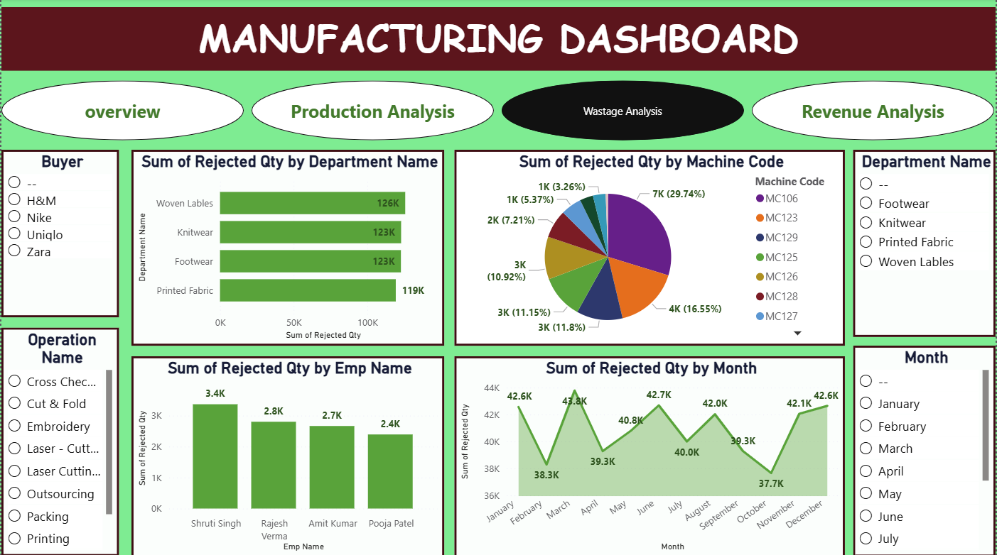
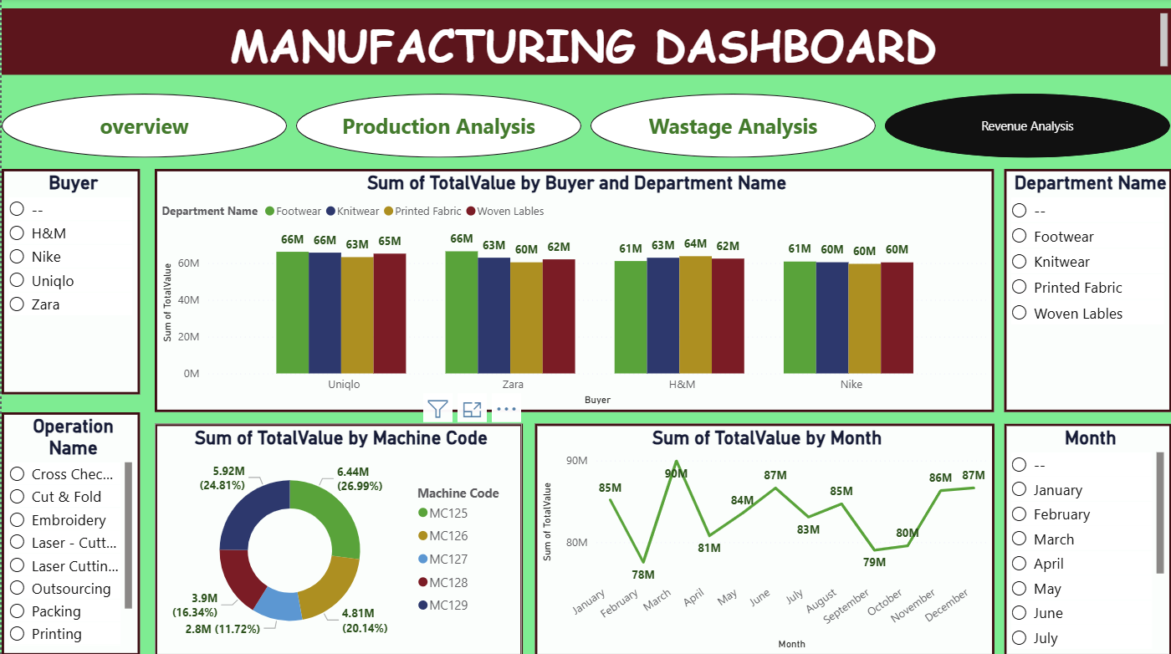
Power BI Dashboard

Slide 14
Power BI Dashboard

Slide 15
Power BI Dashboard

Slide 16
Power BI Dashboard

Slide 17
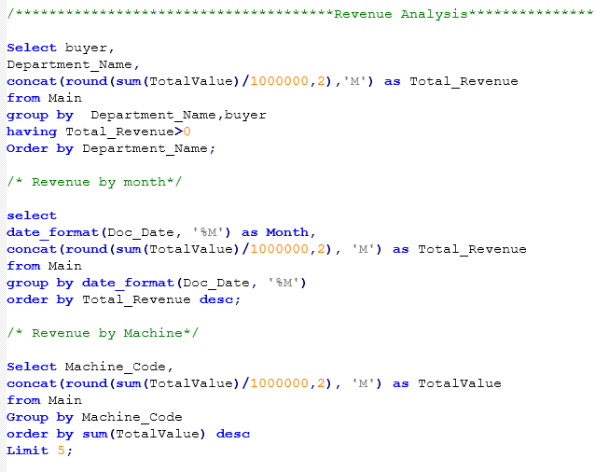
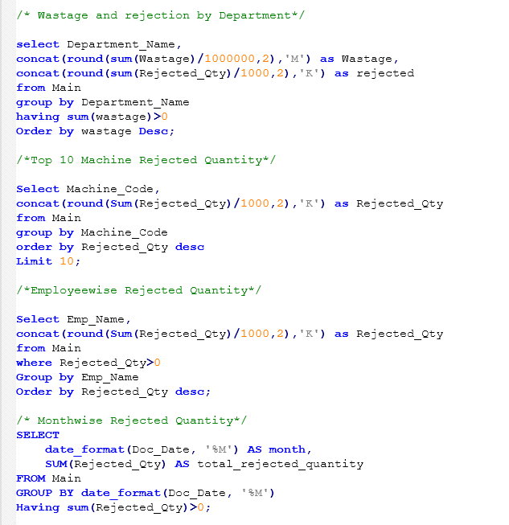
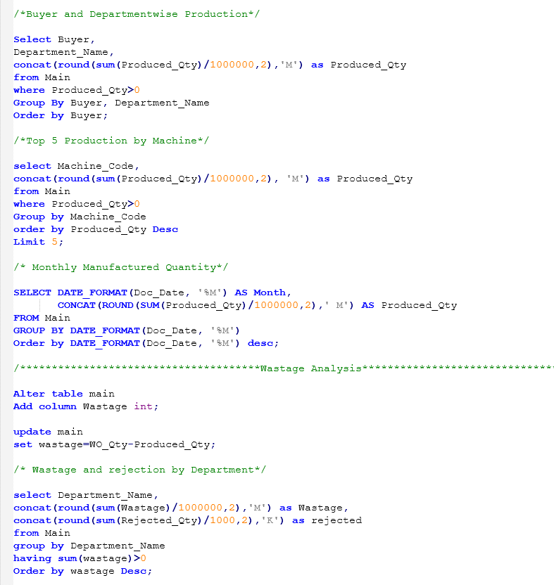
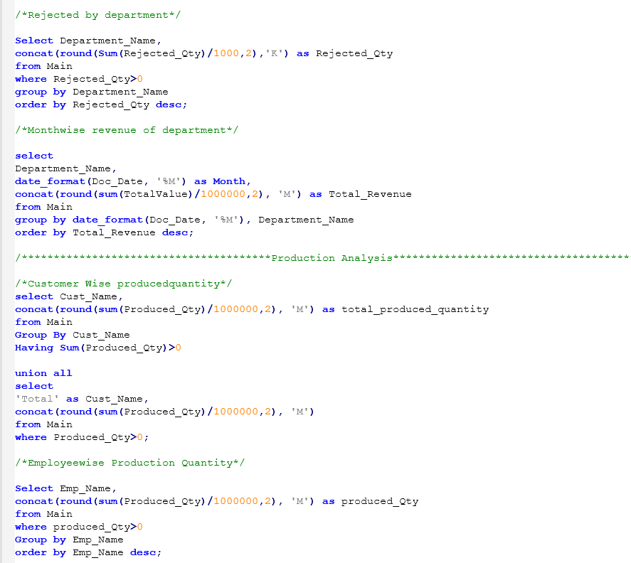
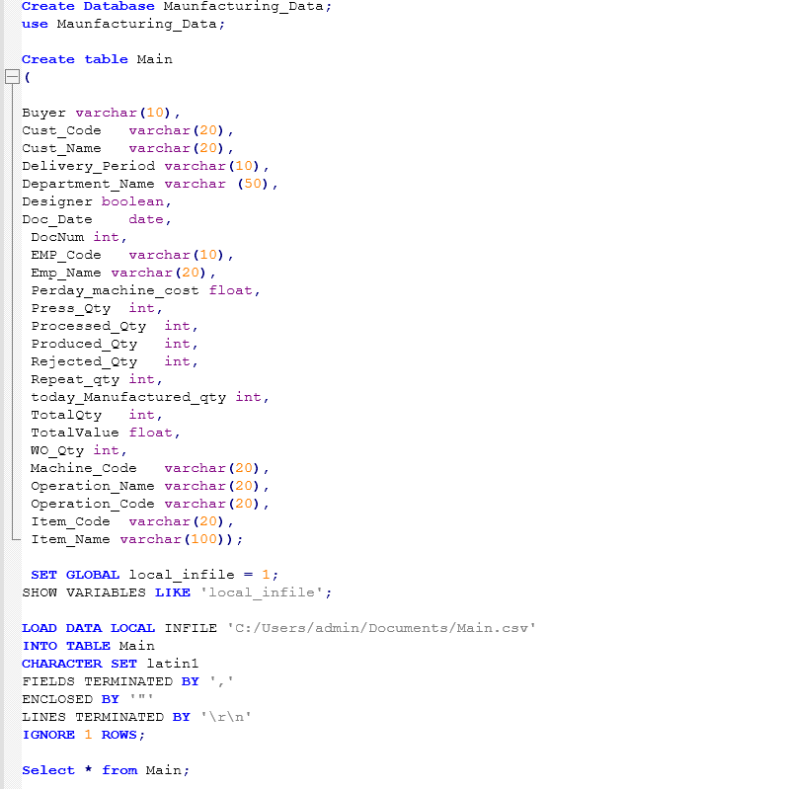
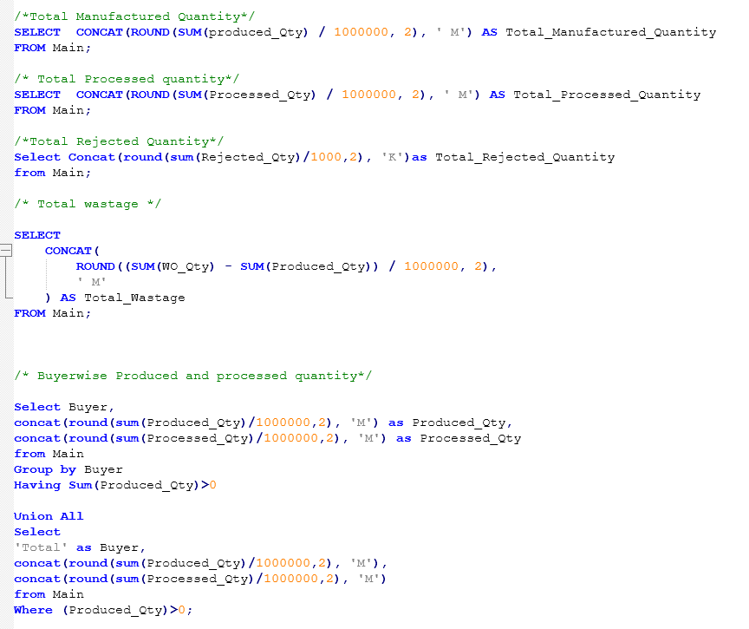
SQL Query

Slide 18
Findings:
Revenue is strong but heavily dependent on a few key buyers.
Production volume is high, indicating strong operational capacity.
On-time delivery rate is below optimal performance standards.
Early and late deliveries are almost equal, showing planning inconsistency.

Slide 19
Suggestions:
Enhance OnTime Delivery
Optimise Machine Utilisation & Costs
Improve Quality Control
Leverage Repeat Orders Insight
Empower Employees with Data
Integrate Dashboards with ERP

Slide 20
THANK YOU

